Slide 1

Hotel Management Network System
Supervisor: Mr. Imran Ahmed
Group Members Name
Hasnat Masood (BIET-F21-001)
Syed Abdul Qayyum (BIET-F21-007)
Tayyab Nadeem Butt (BIET-F21-028)
Muhammad Nabeel (BIET-F21-042)
Department of Information Engineering Technology
1

Slide 2

Introduction
Brief Overview of the Project:
Our Hotel System Network Design Project is a major tech upgrade, carefully planned to meet the modern needs of hotel management.
Importance of a Comprehensive Network System for a Hotel:
In today's digital world, a strong network is crucial for guest happiness and smooth hotel operations, ensuring seamless communication and instant updates.
Commitment to Guest Satisfaction, Efficiency, and Data Security:
We're dedicated to offering guests a special experience, improving staff efficiency, and securing guest data, making our hotel better for everyone through technology.
Department of Information Engineering Technology
2

Slide 3

Objectives
Network Infrastructure
Guest Wi-Fi
Reservation System Integration
Security Measures
Enhanced guest experience
Improved hotel management efficiency
Enhanced network security
Future-proof network design
Department of Information Engineering Technology
3

Slide 4
Deliverables
Network Infrastructure
Detailed network design documentation
Hardware procurement and installation
VLAN configuration
Structured cabling installation
Guest Wi-Fi
Secure guest Wi-Fi access
Captive portal for guest authentication
Department of Information Engineering Technology
4

Slide 5
Deliverables
Reservation System Integration
Seamless integration between the reservation system and network
Real-time room availability updates
Security Measures
Implemented firewall and intrusion detection/prevention systems
Encrypted guest Wi-Fi traffic
Regular security audits and updates
Scalability Plan
Network design for future expansion
Assessment of emerging technologies
Department of Information Engineering Technology
5

Slide 6
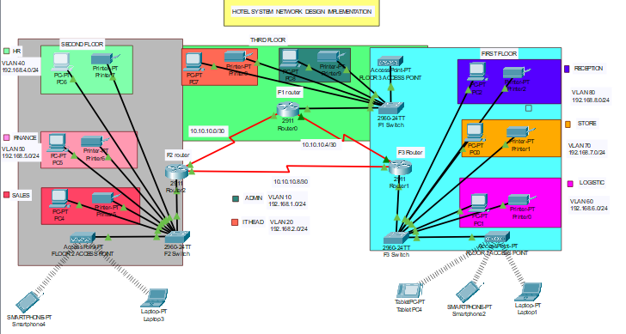
Working of Project
1st Floor:
Reception- VLAN 80, Network of 192.168.8.0/24
Store- VLAN 70, Network of 192.168.7.0/24
Logistics- VLAN 60, Network of 192.168.6.0/24
2nd Floor:
Finance- VLAN 50, Network of 192.168.5.0/24
HR- VLAN 40, Network of 192.168.4.0/24
Sales- VLAN 30, Network of 192.168.3.0/24
3rd Floor
Admin- VLAN 20, Network of 192.168.2.0/24
IT- VLAN 10, Network of 192.168.1.0/24
Department of Information Engineering Technology
6

Slide 7
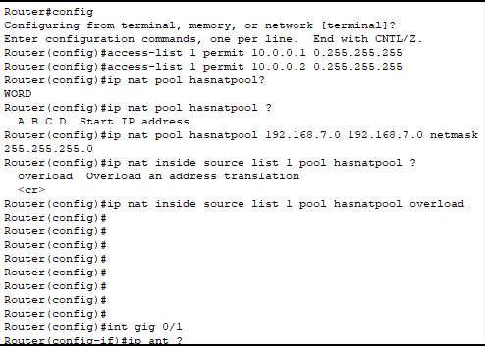
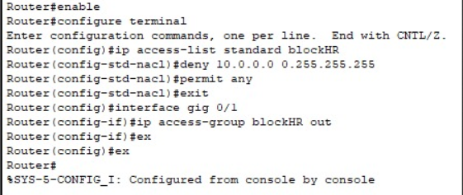
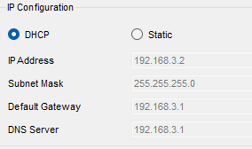
DHCP, ACL, NAT/PAT Configuration
Department of Information Engineering Technology
7

Slide 8
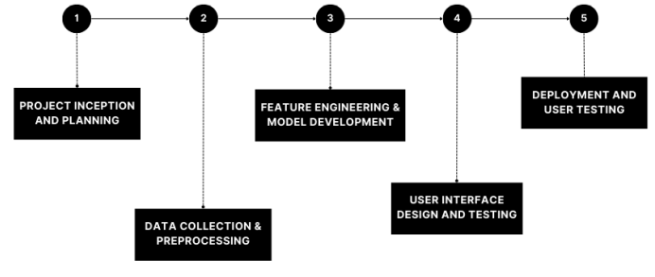
Timelines Chart
Department of Information Engineering Technology
8

Slide 9
Conclusion
The network design implements routers, switches, and Wi-Fi networks across three hotel floors, ensuring seamless communication between departments while maintaining security through VLAN segmentation. This infrastructure optimizes operations, providing efficient device connectivity and supporting distinct departmental functionalities.
Overall, this design aligns with the hotel's organizational hierarchy, ensuring efficient communication, secure connectivity, and streamlined operations across all departments within the multi-floor establishment.
Department of Information Engineering Technology
9

Slide 10
References
Jingda Yang- "Research and Design of Hotel Management System Model" ,Published by Atlantis Press,ICETIS 2019,
Ogirima S. A. O.- "Online computerized Hotel Management System",ResearchGate,April 2010, Online_computerized_Hotel_Management_System
Md. Noor-A-Rahim1, Md. Kamal Hosain2, Md. Saiful Islam3, Md. Nashid Anjum4 and Md. Masud Rana5- "An Electronic Intelligent Hotel Management System For International Marketplace",(IJACSA) International Journal of Advanced Computer Science and Applications, Vol. 2, No. 3, March 2018
Haemoon Oh,Jee Hye Shin,Byeong-Yong Kim- "Introduction: Tourism and Hospitality Marketing Research - Update and Suggestions", ResearchGate , December 2020.
Department of Information Engineering Technology
10

Slide 11

Any Questions
Department of Information Engineering Technology
11
11

